Slide 1
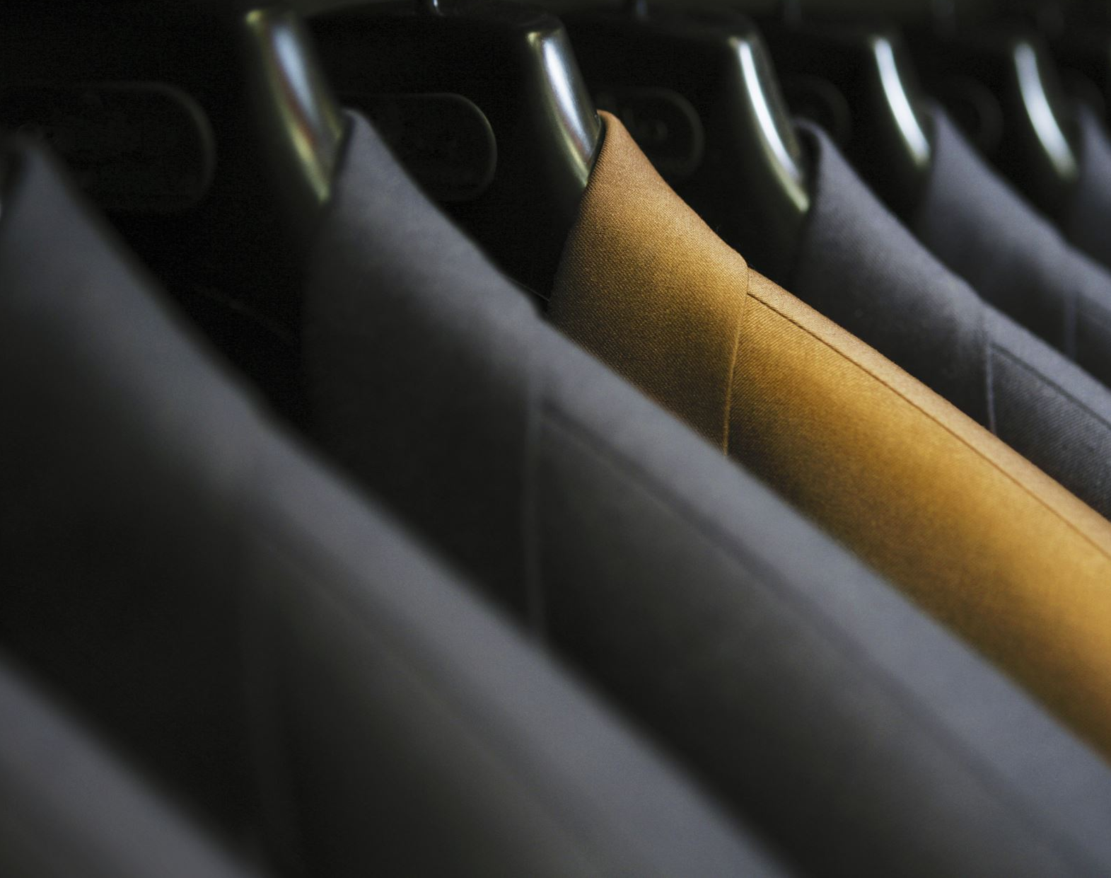
FASHION MNIST CLASSIFICATION
SUBMITTED BY:
MIHIR SHAH
PRATIK MAHAJAN
NISHIT PABARI
RUSHABH SHAH

Slide 2
INTRODUCTION
The primary aim of the project is to accurately classify and identify the different types of clothes.
The different types of clothes in our dataset are T-shirts, Trousers, pullovers, Dress, Coat, Sandal, shirts, sneakers, bags, and Ankle Boot.
The dataset consists of pixel values that range from 0 to 255 with 0 being white and 255 being black.
We have scaled these pixel values to get them in the range of 0 to 1 for computational efficiency.
Logistic Regression, Support Vector Machine, and Neural Networks are the three models that we have implemented in order to make accurate predictions of the different types of clothes.

Slide 3
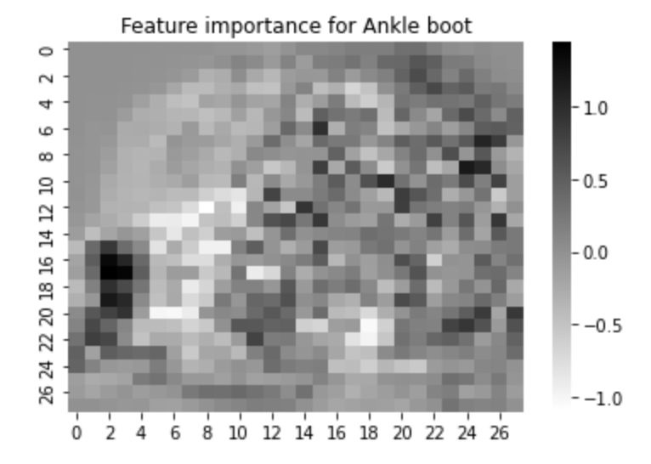
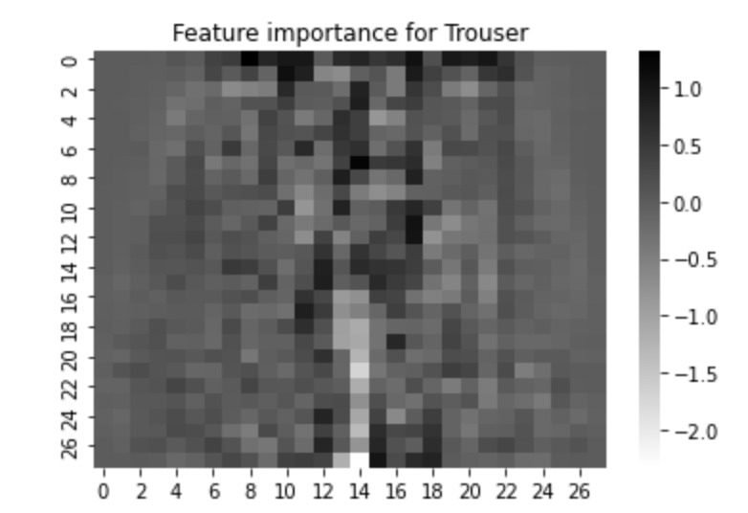
Feature Selection

Slide 4
LOGISTIC REGRESSION
Using Ridge Regularization

Slide 5
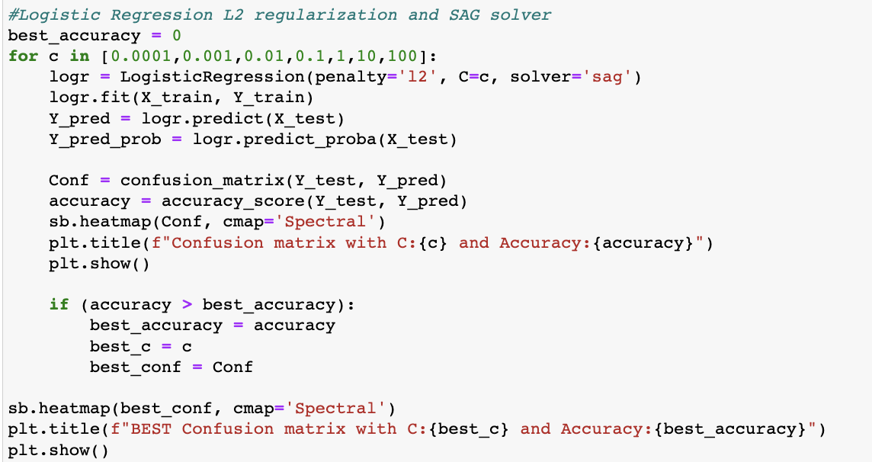
Code Snippet

Slide 6
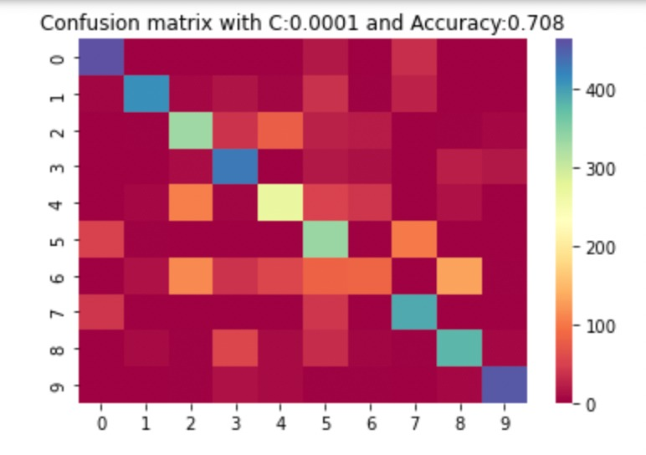
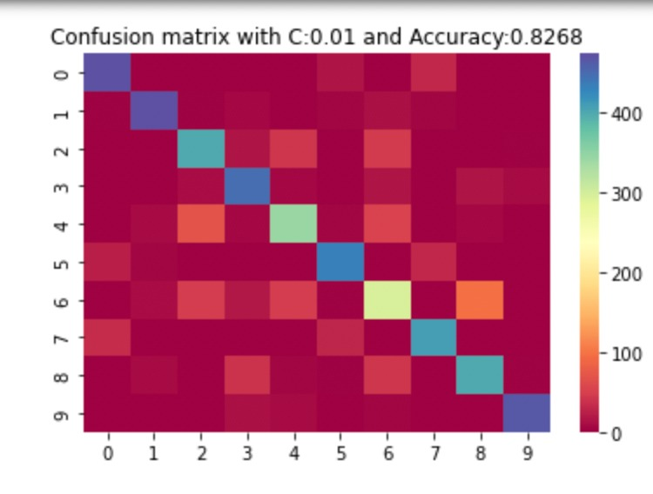
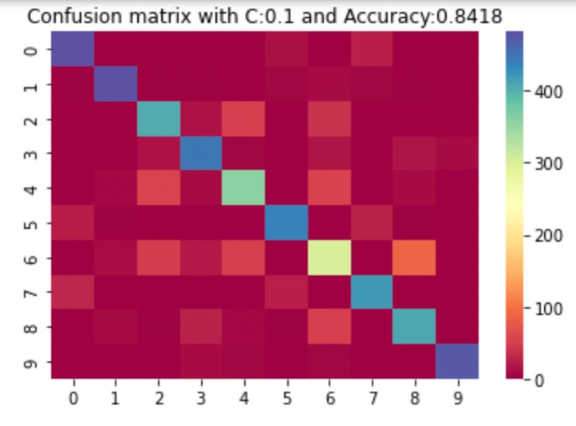
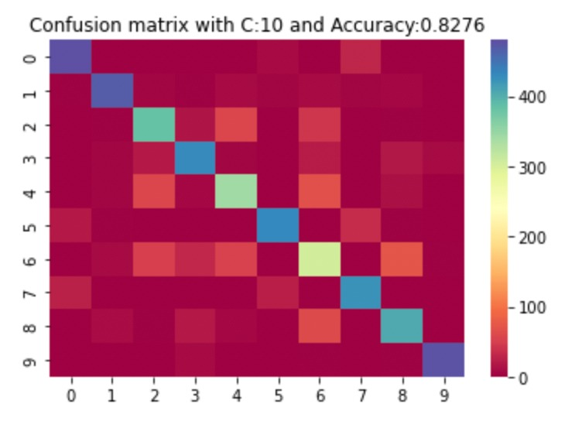
ALL CONFUSION MATRIX

Slide 7
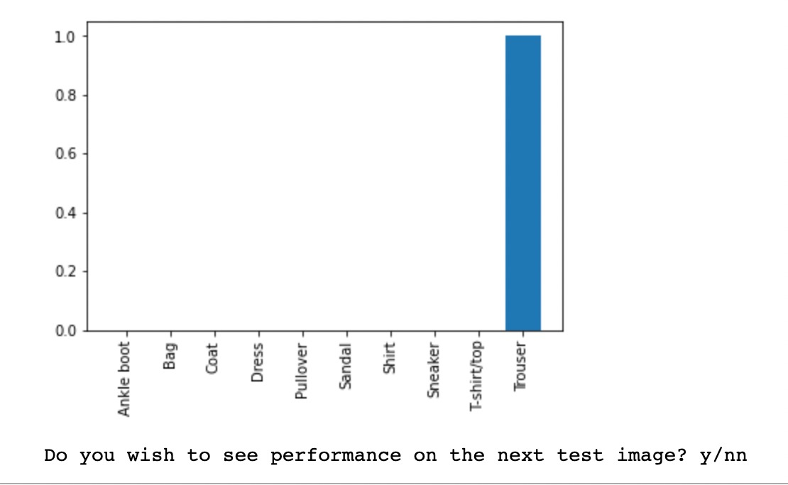
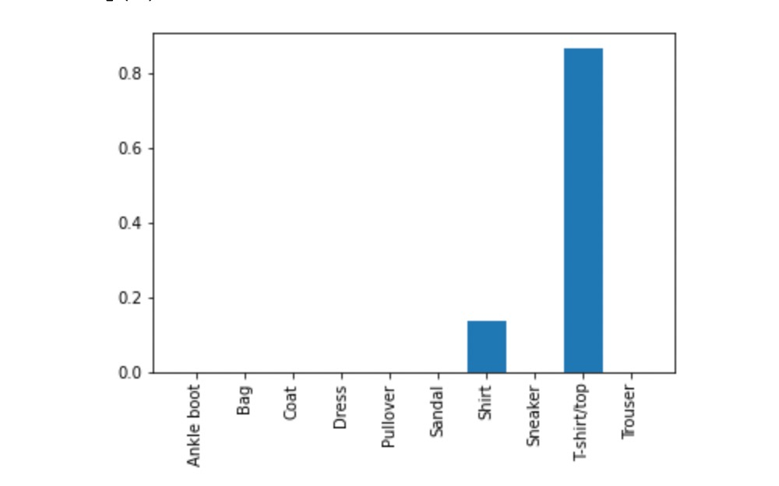
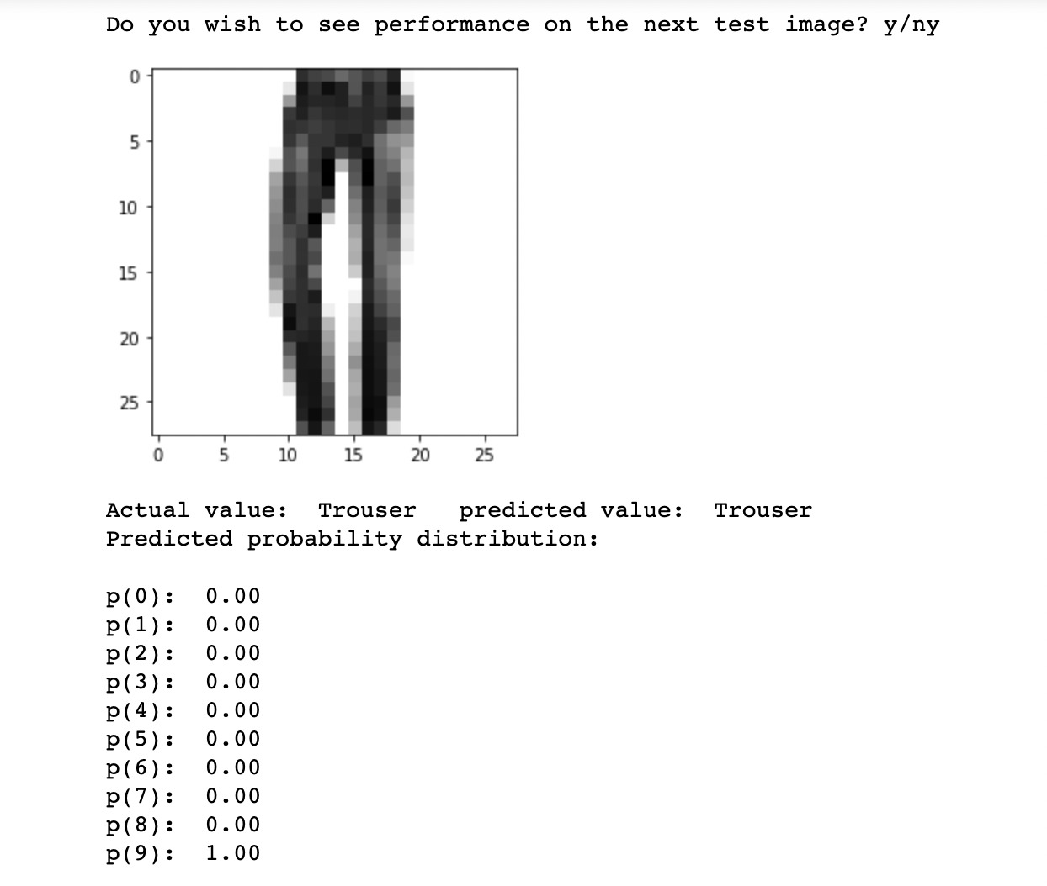
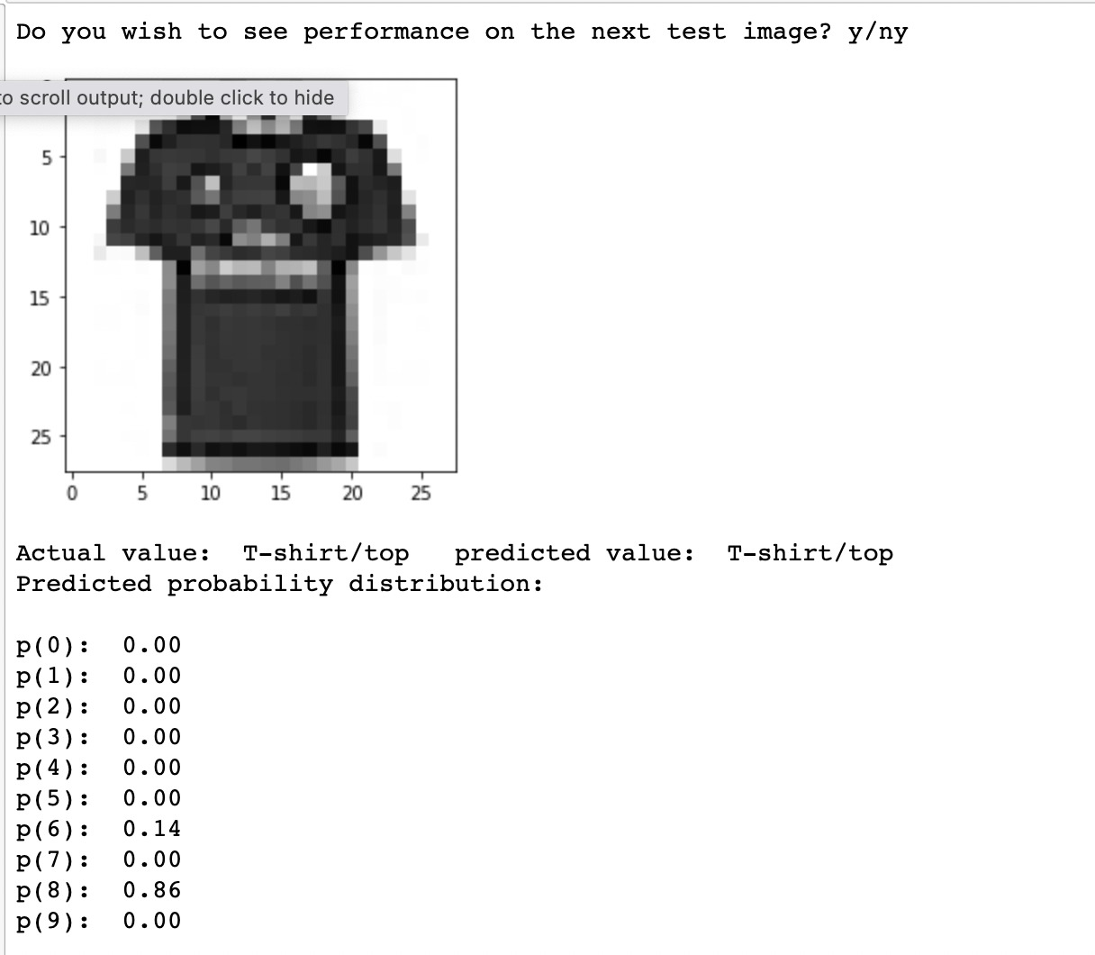
Logistic Regression Ridge Model; Prediction of T-shirt/top and Trouser

Slide 8
LOGISTIC REGRESSION
Using LASSO regularization

Slide 9
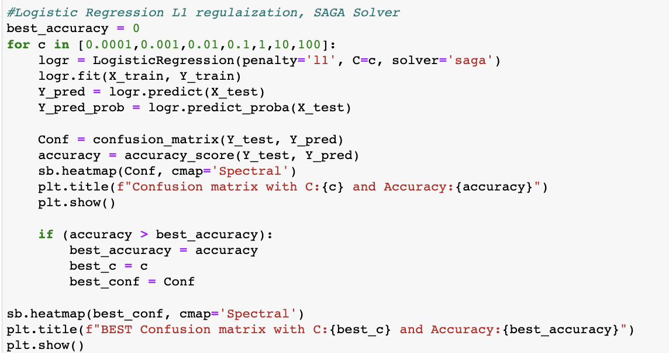
Code Snippet

Slide 10
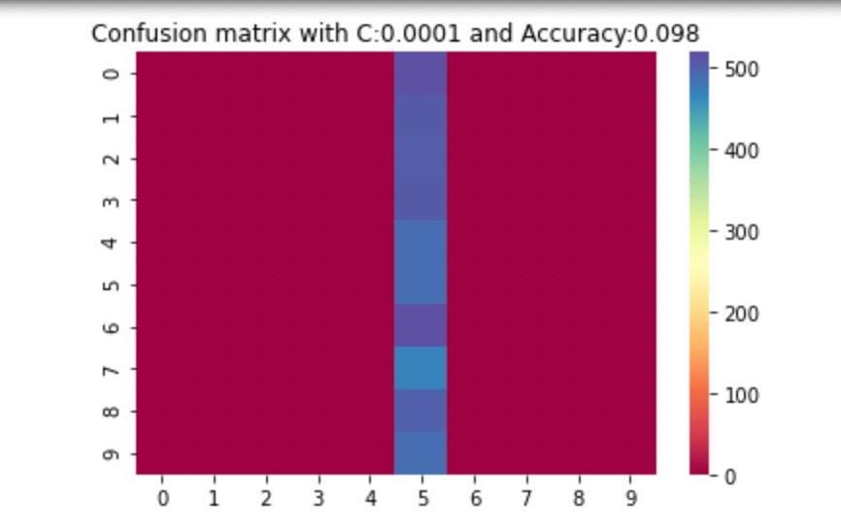
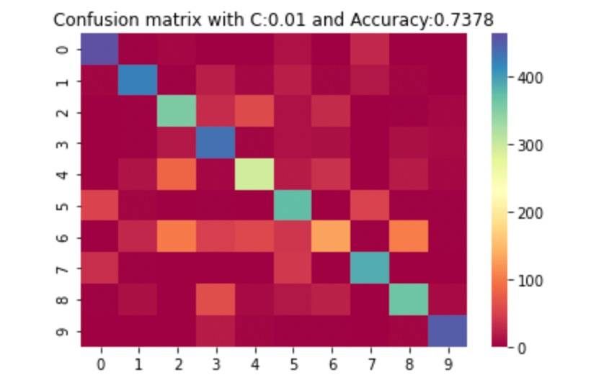
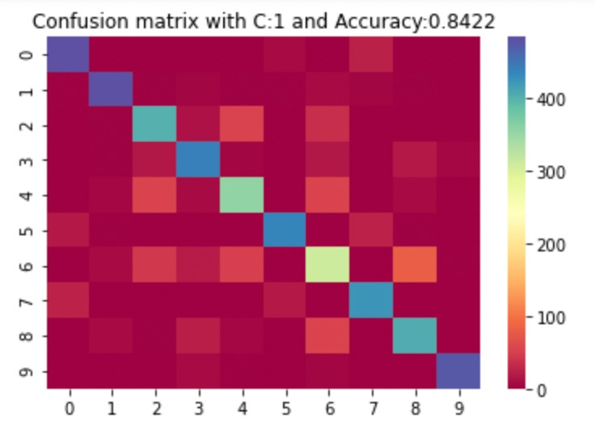
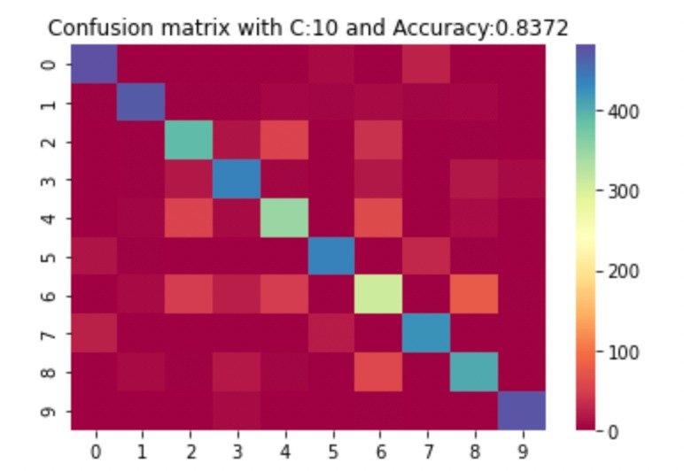
ALL CONFUSION MATRIX

Slide 11
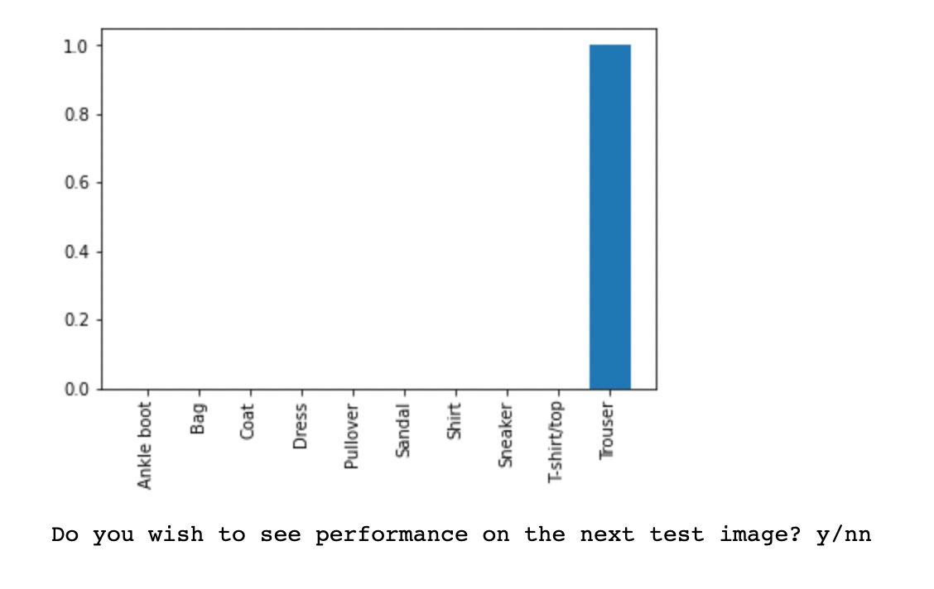
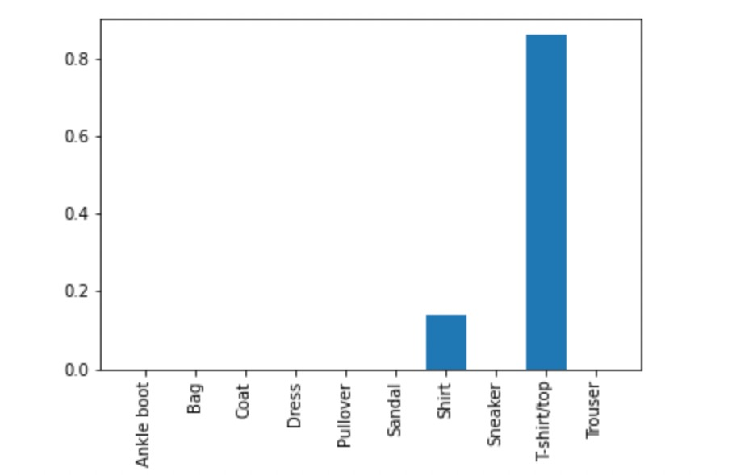
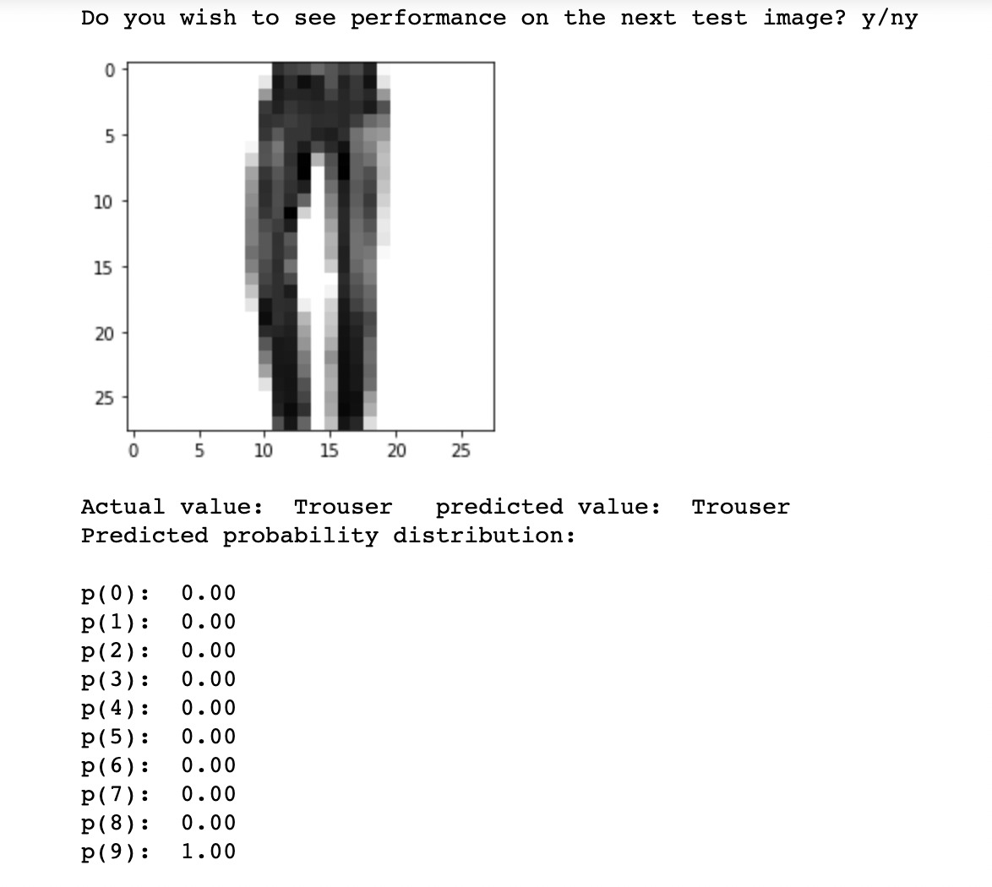
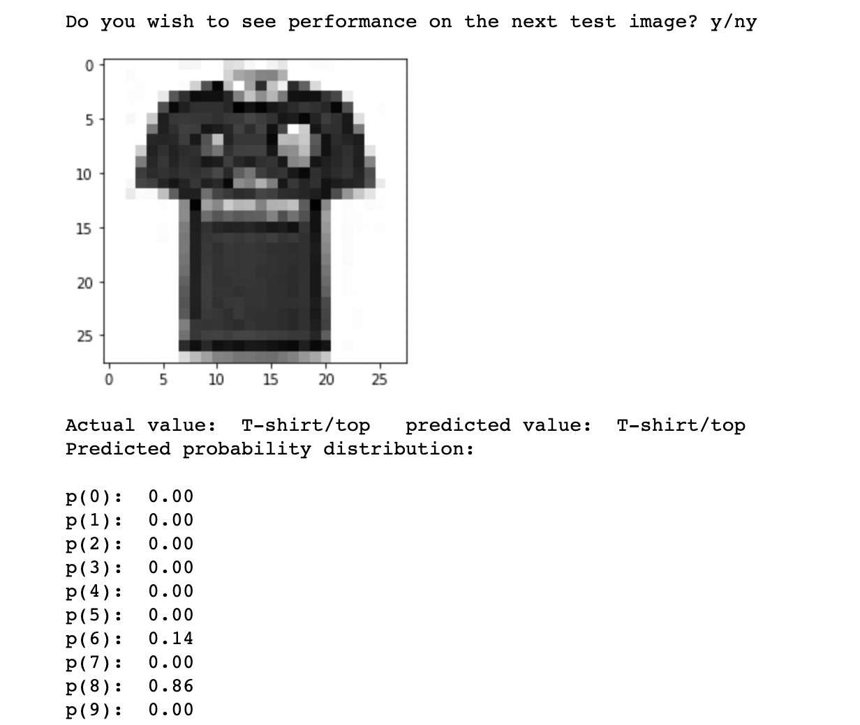
Logistic Regression LASSO Model; Prediction of T-shirt/top and Trouser

Slide 12
SUPPORT VECTOR MACHINE
Linear Model

Slide 13
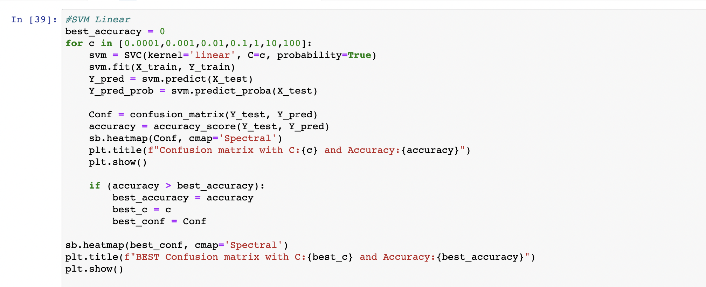
Code Snippet

Slide 14
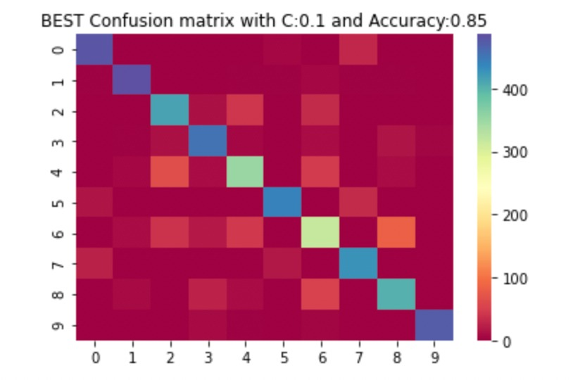
CONFUSION MATRIX
This is the best confusion matrix with an Accuracy of 85%.

Slide 15
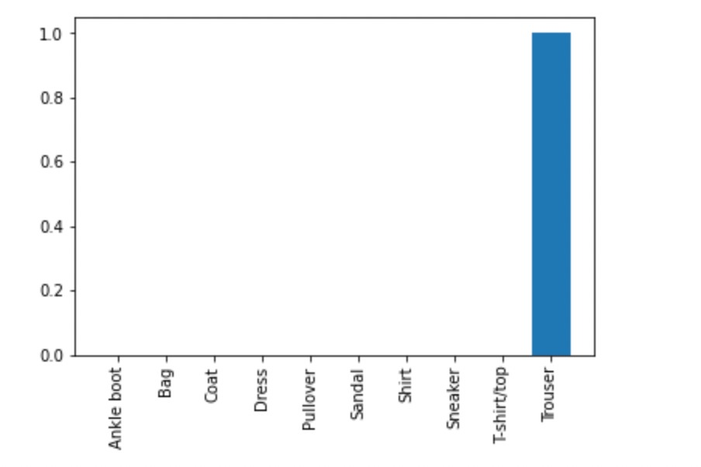
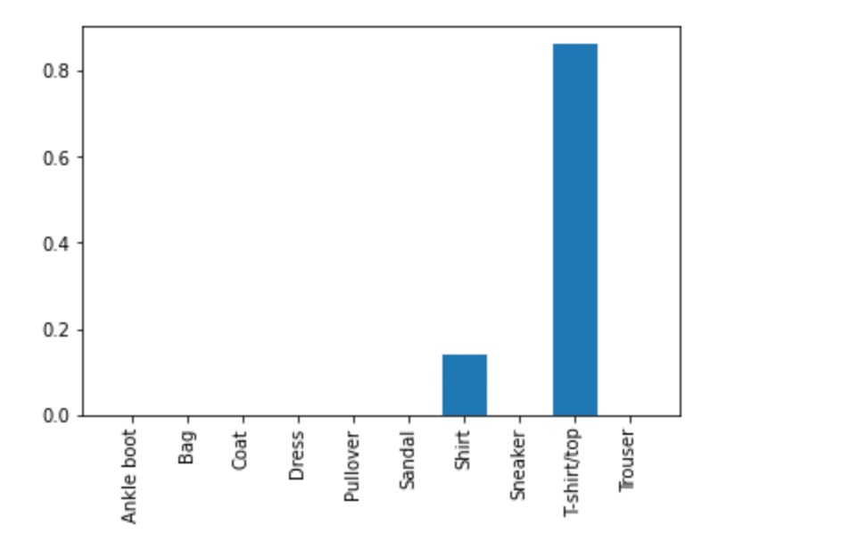
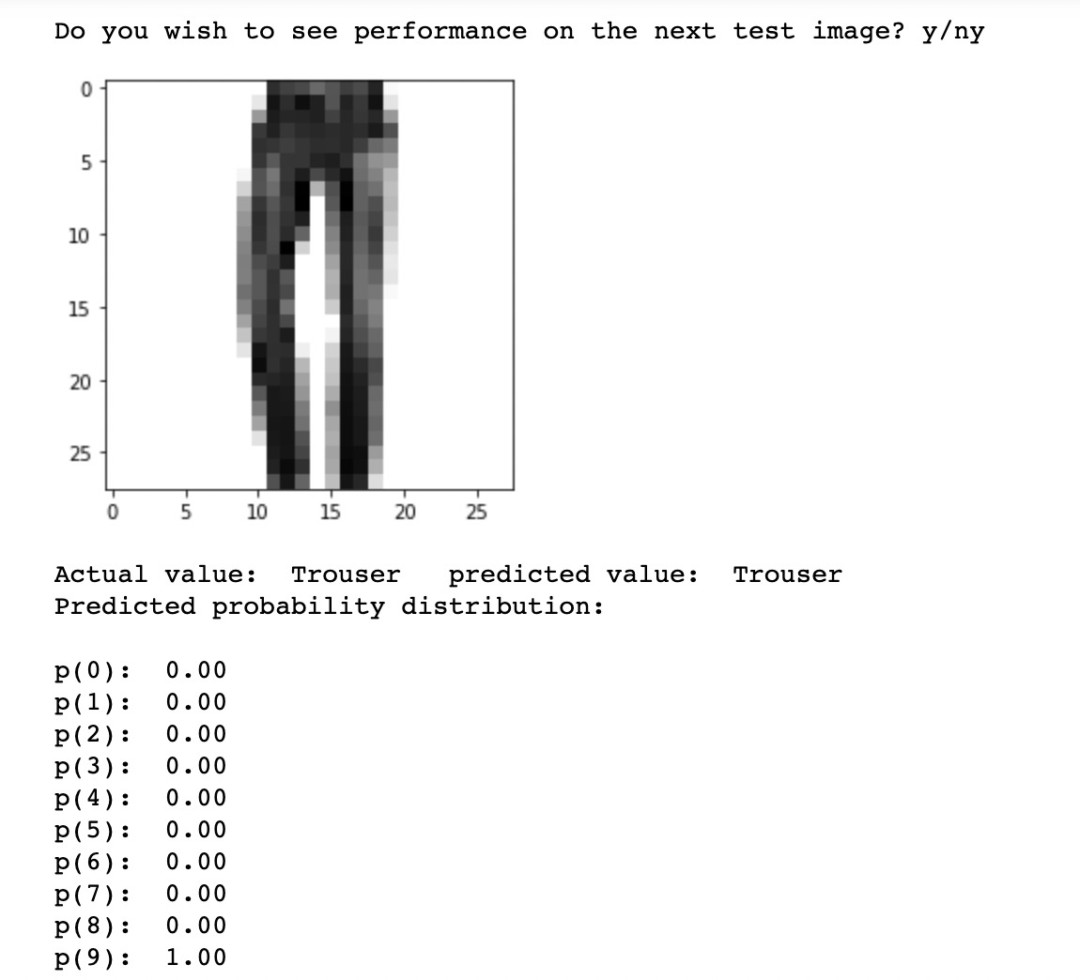
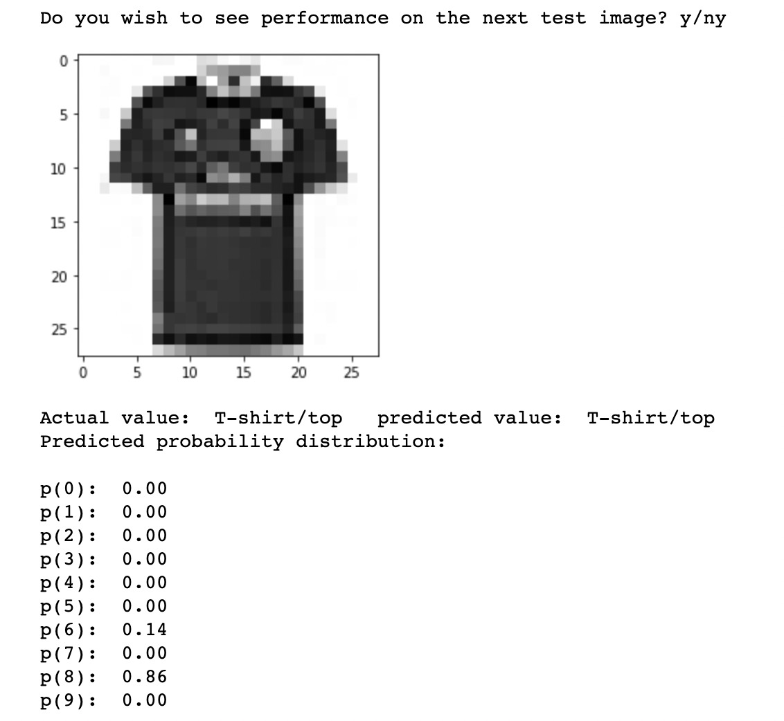
Support Vector Machine(Linear); Prediction of T-shirt/top and Trouser

Slide 16
SUPPORT VECTOR MACHINE
Gaussian Radial Model

Slide 17
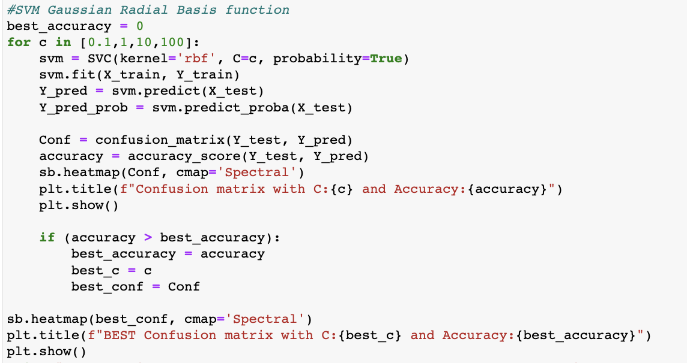
Code Snippet

Slide 18
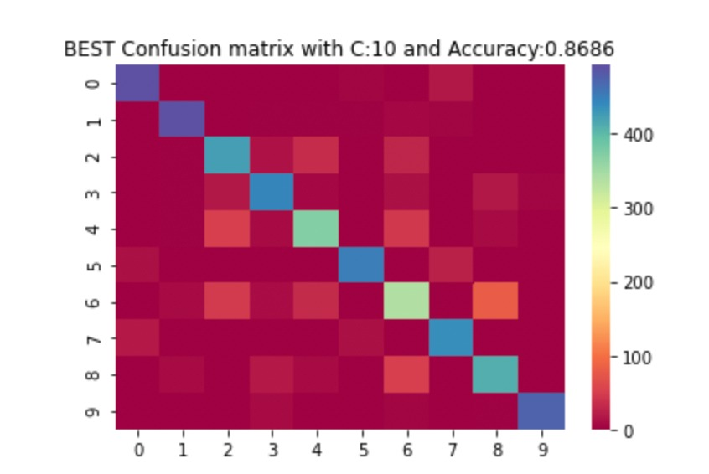
CONFUSION MATRIX
This is the best confusion matrix with an Accuracy of 86.86%.

Slide 19
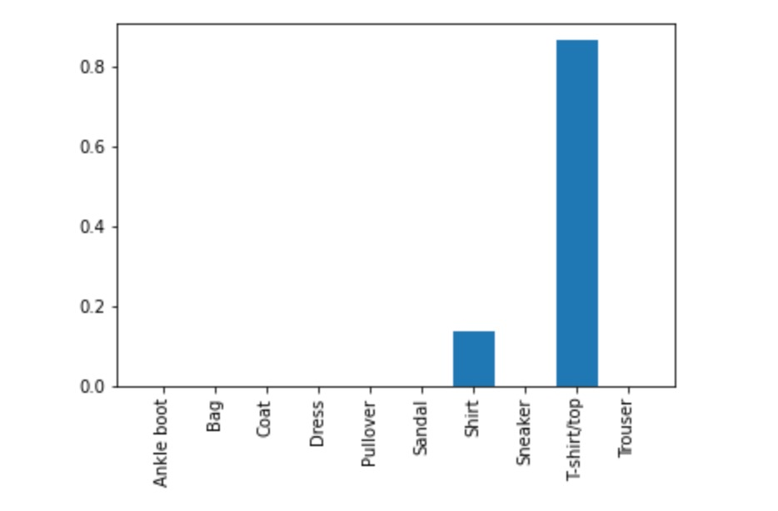
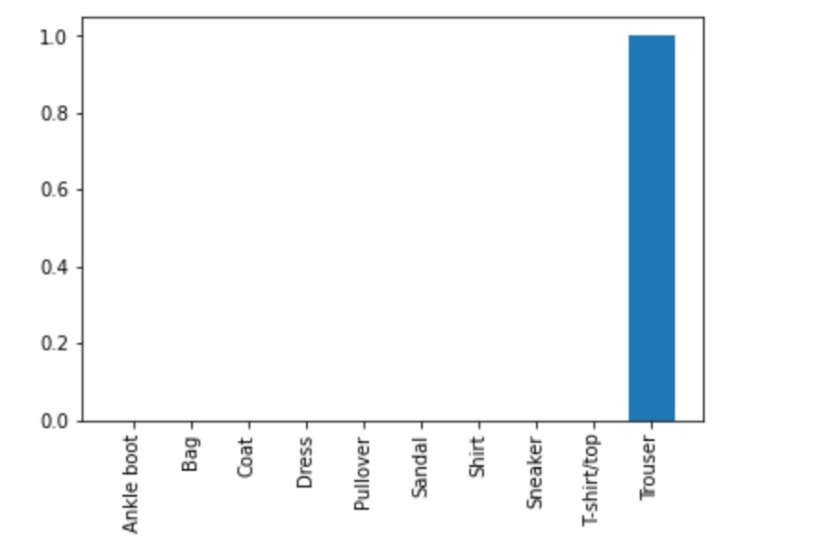
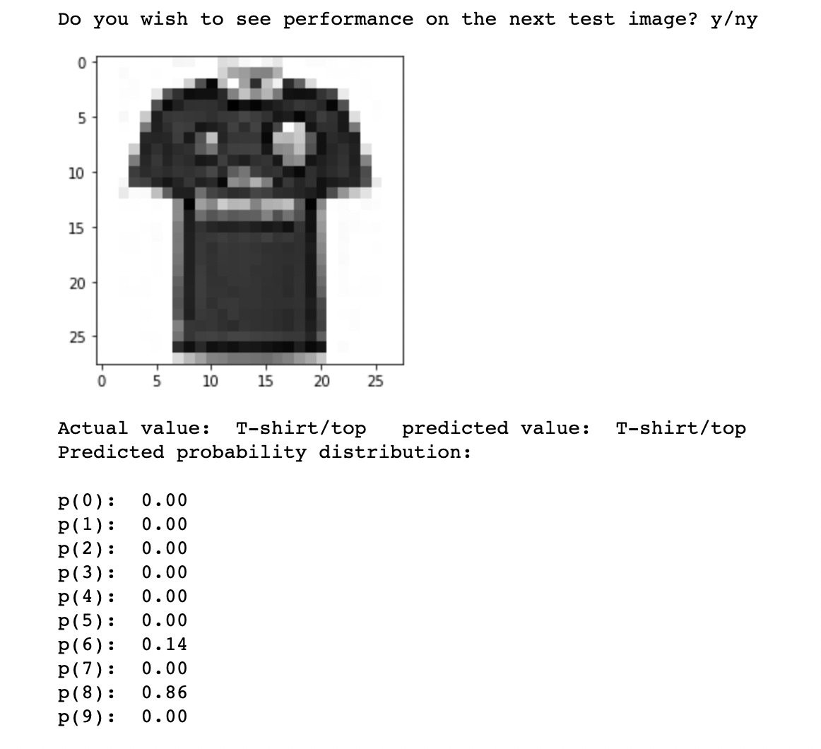

Support Vector Machine(Gaussian Radial); Prediction of T-shirt/top and Trouser

Slide 20
SUPPORT VECTOR MACHINE
Polynomial Model

Slide 21
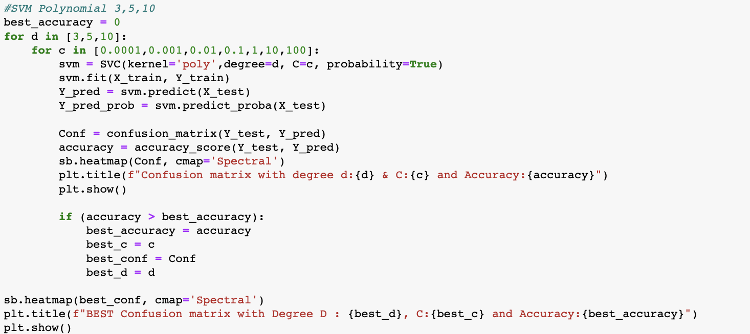
Code Snippet

Slide 22
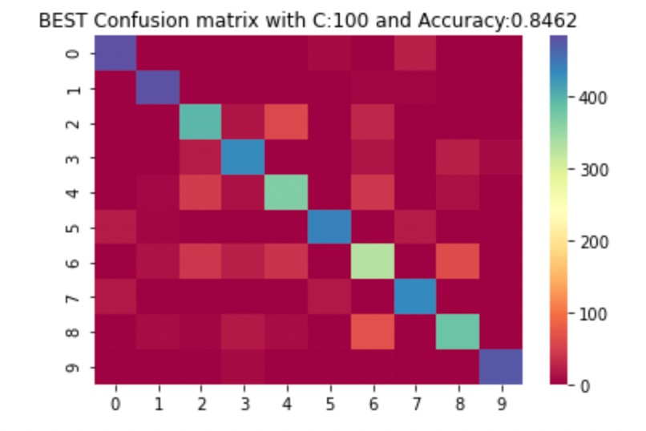
CONFUSION MATRIX
This is the best confusion matrix with an Accuracy of 84.62 %.

Slide 23
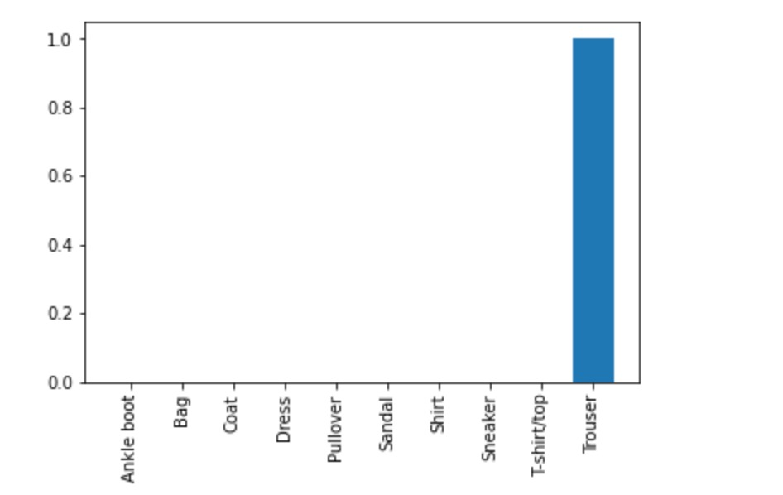
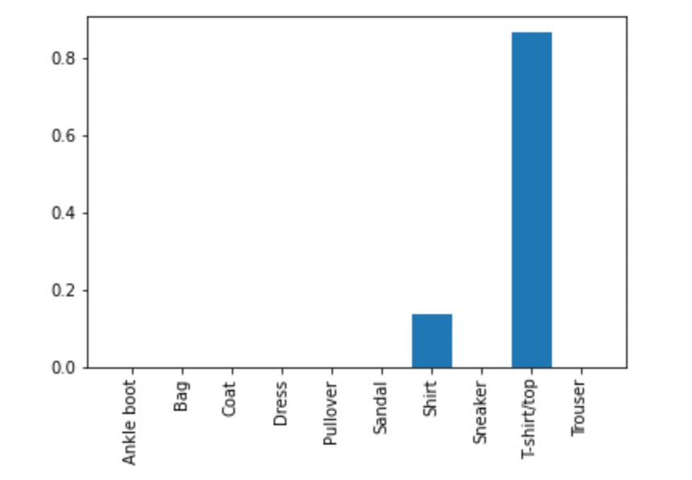

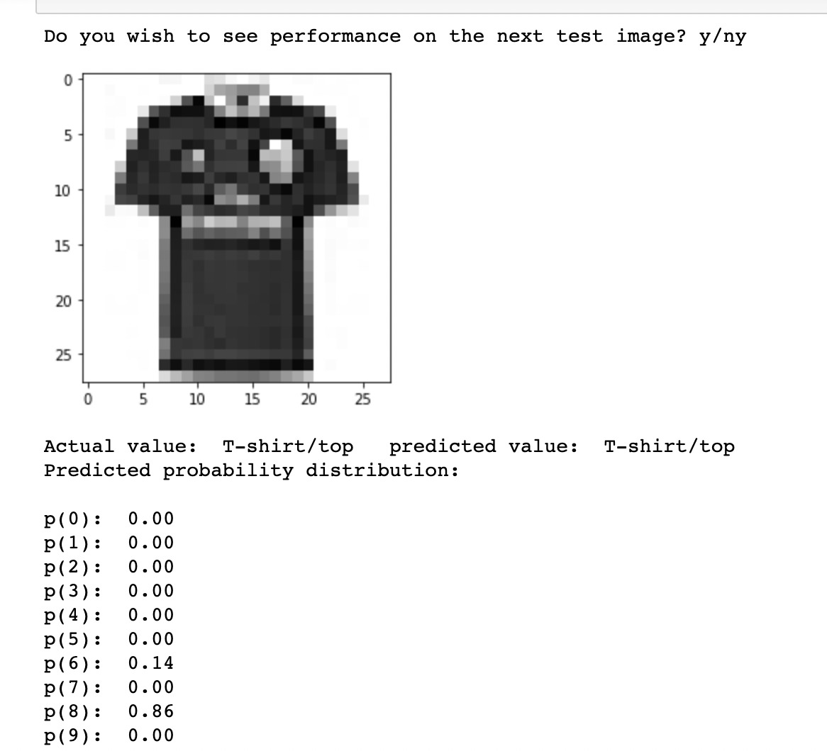
Support Vector Machine(Polynomial); Prediction of T-shirt/top and Trouser

Slide 24
NEURAL NETWORK
3 layers Model

Slide 25
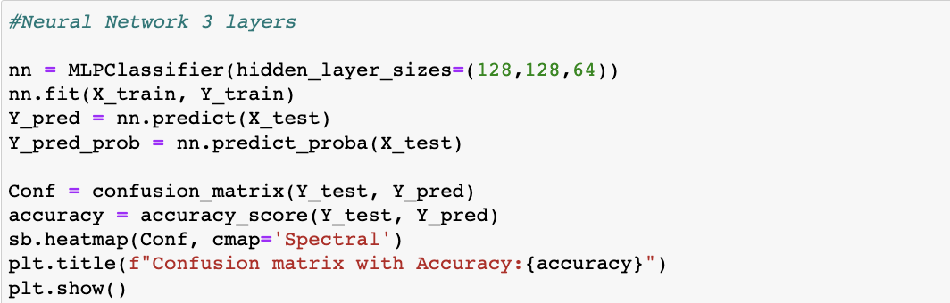
Code Snippet

Slide 26
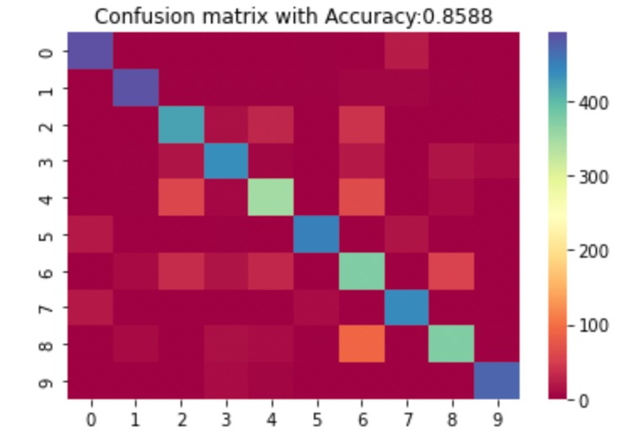
CONFUSION MATRIX
This is the best confusion matrix with an Accuracy of 85.88 %.

Slide 27
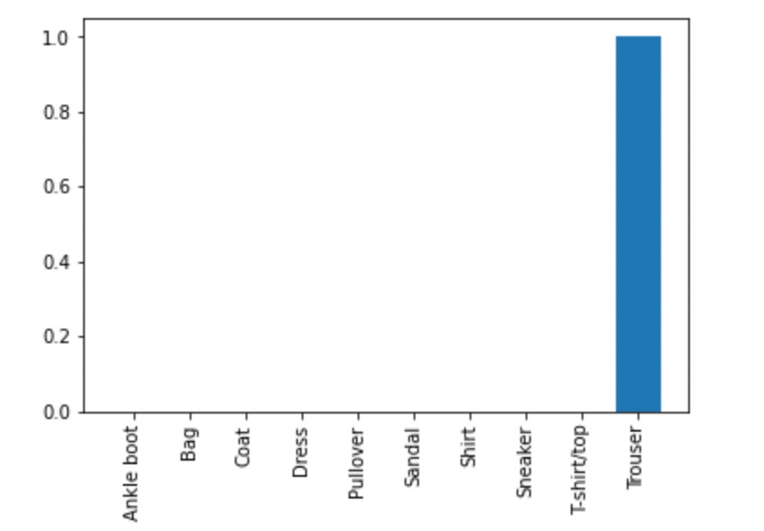
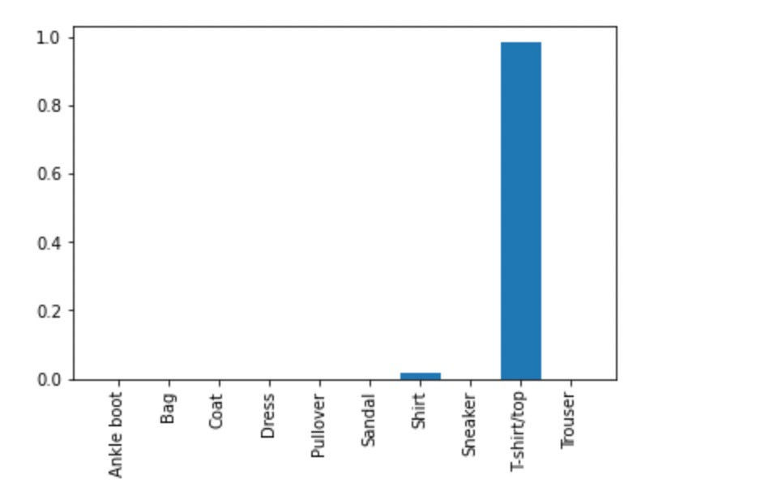
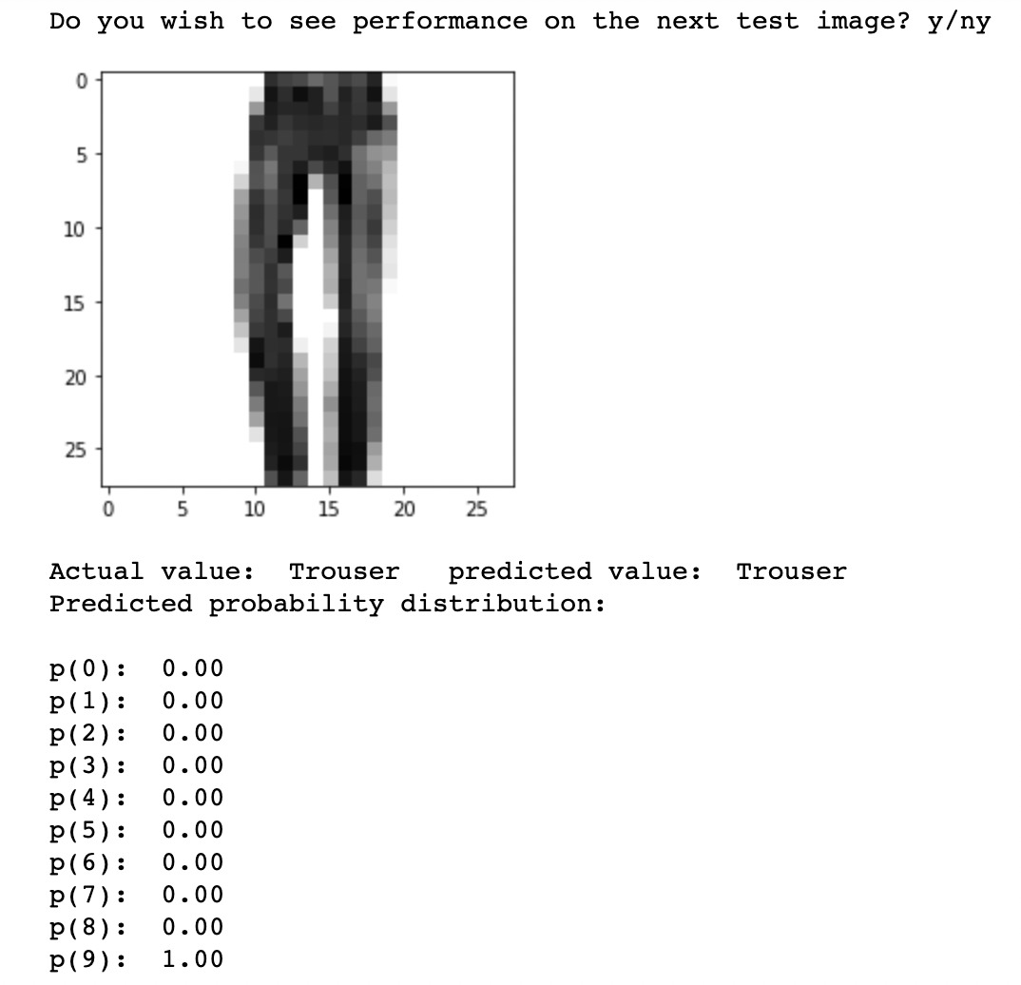
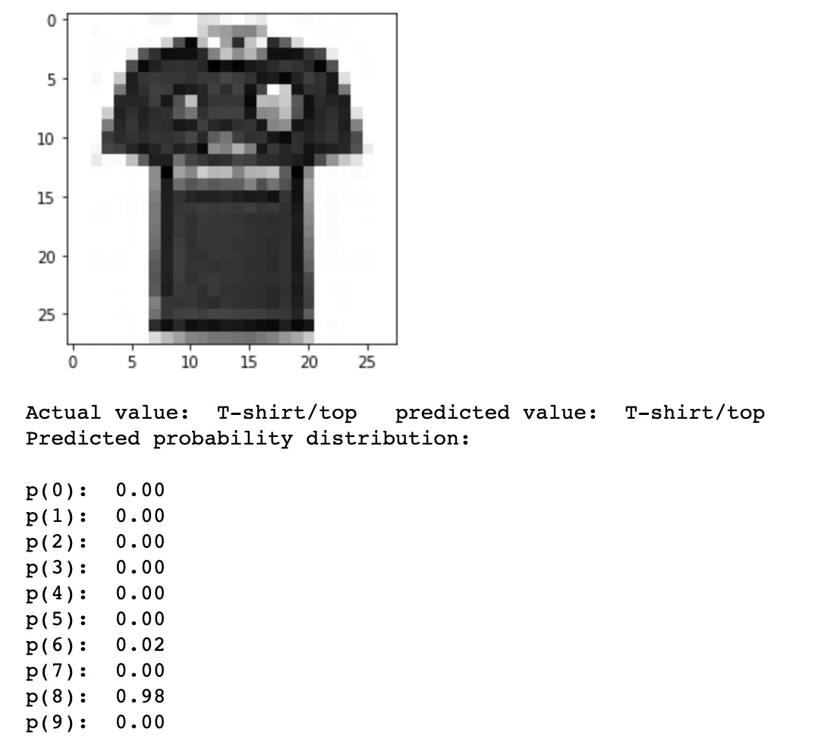
Neural Network 3 layers; Prediction of T-shirt/top and Trouser

Slide 28
Neural Network
4 layers Model

Slide 29
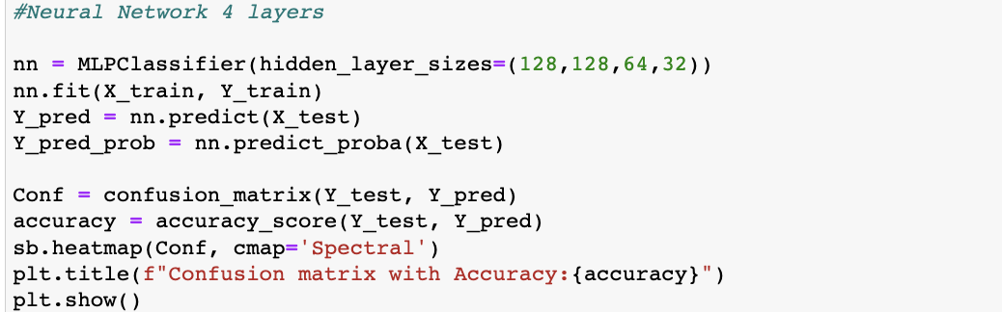
Code Snippet

Slide 30
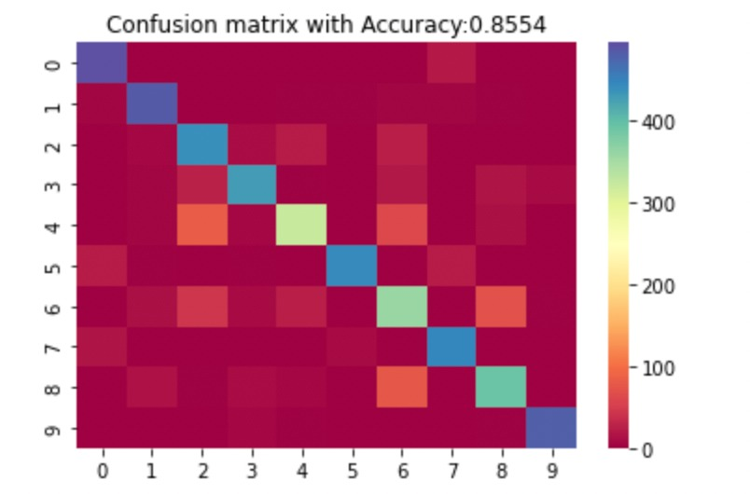
CONFUSION MATRIX
This is the best confusion matrix with an Accuracy of 85.54 %.

Slide 31
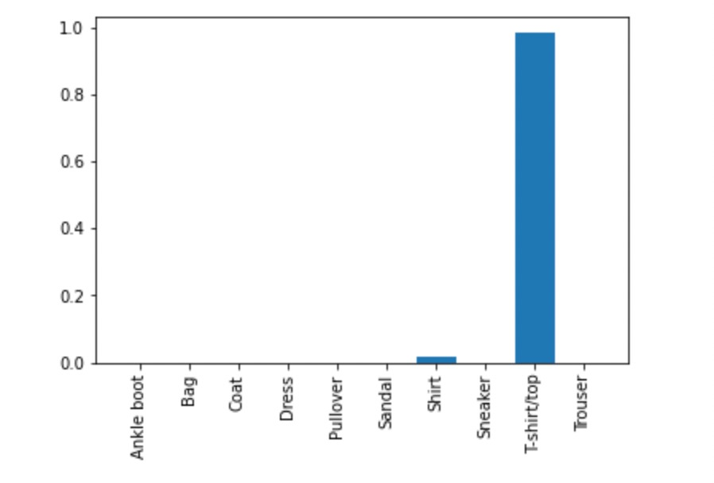
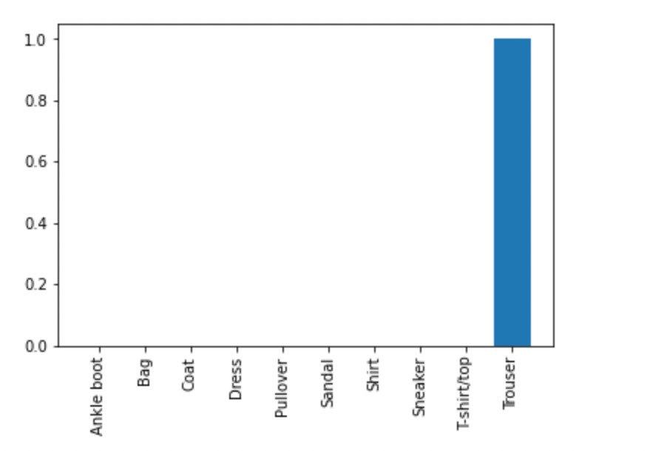
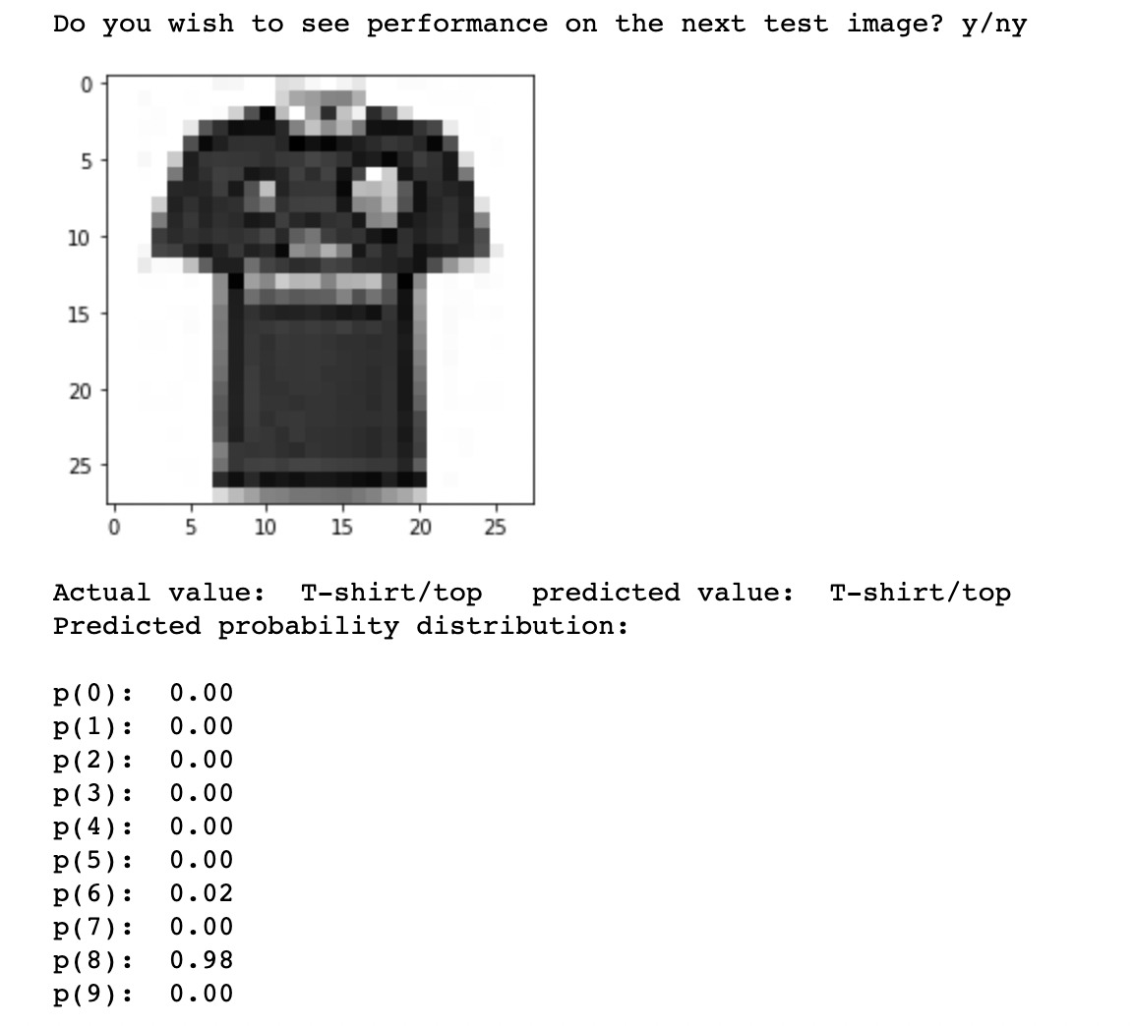
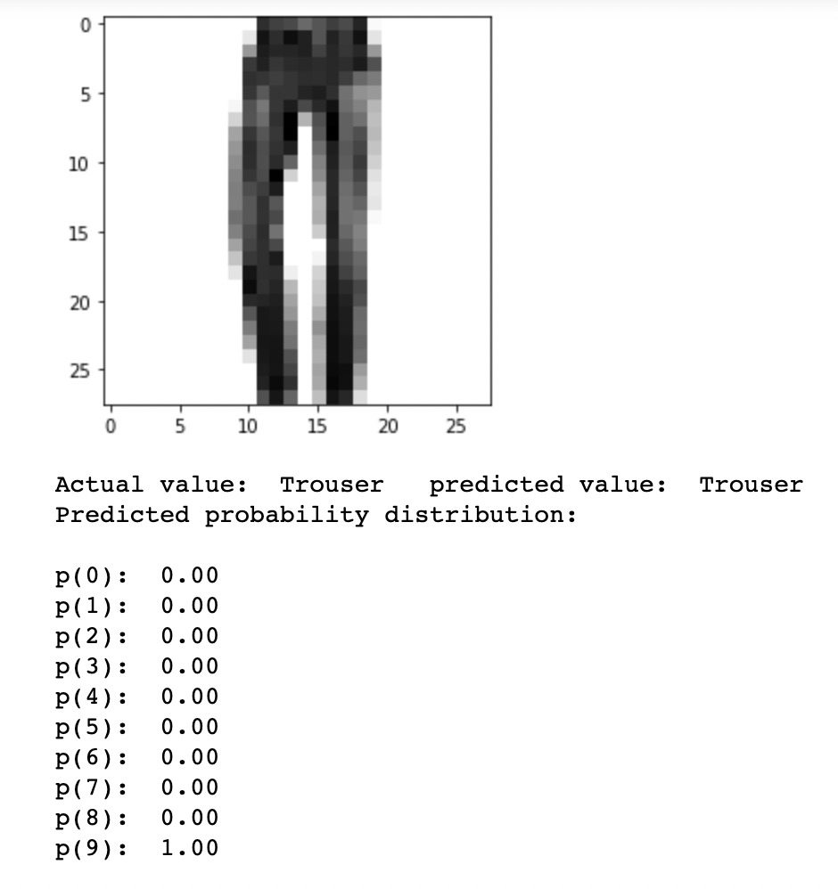
Neural Network 4 layers; Prediction of T-shirt/top and Trouser

Slide 32
CONCLUSION
The Support Vector Machine(SVM) with Gaussian Radial function has the best accuracy score of 86.86%.
Neural Networks show the highest probability functions for each of the predictions as compared to the other models.
We were able to learn that each model performs best for different c values which are the inverse of the learning rate.

